Slide 1
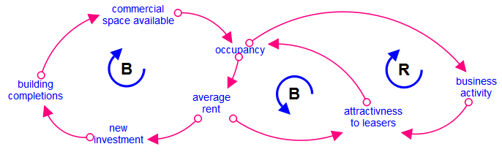
INTRODUCTION
Copy and paste your text content here, adjusting the font size to fit into the textbox.
GOAL
Copy and paste your text content here, adjusting the font size to fit into the textbox.
METHOD
Copy and paste your text content here, adjusting the font size to fit into the textbox.
Write the Poster title here Write the Poster title here Write the Poster title here Write the Poster title here Write the Poster title here
RESULTS
Importing / inserting files: Images such as photographs, graphs, diagrams, logos, etc, can be added to the poster. Avoid long numerical tables as they will be difficult to read.
To insert images, go through the menus as follows: Insert / Picture / From File. Locate the file on your computer, select and press OK. Please ensure all image files are JPEG/PNG, other formats may cause images to get corrupted after saving.
Be aware of the image size you are importing.
The recommended font for captions is Arial, no smaller than 15 pt. Left aligned if it refers to a figure on its left. Start the captions right at the top edge of the picture (graph or photo).
Notes about graphs: For simple graphs use Microsoft Excel or create the graph directly in PowerPoint.
Graphs created in a scientific graphing program (e.g.. Sigma Plot, Prism, SPSS, Statistics) should be saved as JPEG or TIFF.
The recommended font is Arial no smaller than 15
The recommended font is Arial no smaller than 15
First Name Last Name
First Name Last Name
First Name Last Name
First Name Last Name
CONTACT INFORMATION
Just highlight this text and replace with your own text.
Use this space to enter key CLD or result. A short summary to allow viewers to learn about your research
CONCLUSIONS
Copy and paste your text content here, adjusting the font size to fit into the textbox.
EXAMPLE
AFFILIATION LOGO
Delete placeholder rectangle

Slide 2
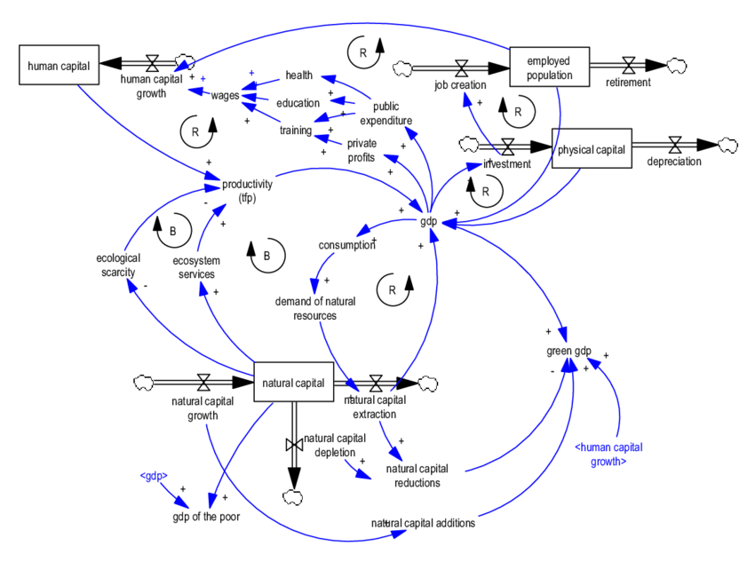
Write the Poster title here Write the Poster title here Write the Poster title here Write the Poster title here Write the Poster title
First Name Last Name — First Name Last Name — First Name Last Name — First Name Last Name
PURPOSE / OBJECTIVES
Use this space to enter key CLD or result. A short summary to allow viewers to learn about your research
RESULTS
Copy and paste your text content here, adjusting the font size to fit into the textbox.
Figure 1
EXAMPLE
MATERIAL & METHODS
Graph 1
Copy and paste your text content here, adjusting the font size to fit into the textbox.
EXAMPLE
EXAMPLE
CONCLUSION
Copy and paste your text content here, adjusting the font size to fit into the textbox.
RESULTS
Copy and paste your text content here, adjusting the font size to fit into the textbox.
AFFILIATION LOGO
Delete placeholder rectangle

Slide 3
Write the Poster title here Write the Poster title here Write the Poster title here Write the Poster title here Write the Poster title
First Name Last Name — First Name Last Name — First Name Last Name — First Name Last Name
Introduction
You may edit the size of the font, the sections distribution and the color scheme if wanted. All modifications concerning the background/title display are to be done at a Master Slide level.
Results
Importing / inserting files:
Images such as photographs, graphs, diagrams, logos, etc, can be added to the poster. Avoid long numerical tables as they will be difficult to read.
To insert images, go through the menus as follows: Insert / Picture / From File. Locate the file on your computer, select and press OK. Please ensure all image files are JPEG/PNG, other formats may cause images to get corrupted after saving.
Be aware of the image size you are importing.
Notes about graphs…
For simple graphs use MS Excel, or create the graph directly in PowerPoint.
Graphs created in a scientific graphing program (e.g.. Sigma Plot, Prism, SPSS, Statistics) should be saved as JPEG or TIFF.
EXAMPLE
Goal
How to use this poster template:
Highlight this text and replace it by typing in your own text, or copy and paste your text from a MS Word document or a PowerPoint slide presentation.
The body text / font size should be no smaller than 15 points. Keep body text left-aligned, do not justify text.
Method
Tips for making a successful poster:
Re-write your paper into poster format i.e.. simplify everything, avoid data overkill.
Headings of more than 6 words should be in upper and lower case, not all capitals. Simplify the titles.
Do to write whole sentences in capitals or underline to stress your point, use bold characters instead.
When laying out your poster, leave white space around your text. Don’t overcrowd your poster.
Spell check and get someone else to proof-read.
Conclusions
Highlight this text and replace with your own text.
CONTACT INFORMATION
Just highlight this text and replace with your own text.
AFFILIATION LOGO
Delete placeholder rectangle

