Slide 1

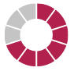



Models and Stories Getting people to act on System Dynamics insights
WIP Presentation
Bob Eberlein, isee systems
Allyson Beall King, Washington State University
Jürgen Strohhecker, Frankfurt School of Finance & Management
0:00-0:30
@systemdynamics_
THE 44TH INTERNATIONAL SYSTEM DYNAMICS CONFERENCE
Delft, Netherlands and Virtually
#isdc2026
Notes:
Title page: Change title to submission name. Bold the name of the presenter and display your name as you want it read by the moderator (eg Bob instead of Robert). Note the suggested timing in the bottom right. Slide timing may be adjusted, but not the number of slides. The session chair will change slide following the timing indicated, or earlier if requested.

Slide 2

Problem Statement
Model results are often not acted upon
Attention
Understandability
Believability
Stories face similar obstacles
Plot and Characterization (Empathy)
Understandability
Verisimilitude
0:30-2:00
@systemdynamics_
THE 44TH INTERNATIONAL SYSTEM DYNAMICS CONFERENCE
Delft, Netherlands and Virtually
#isdc2022
THE 40TH INTERNATIONAL SYSTEM DYNAMICS CONFERENCE
Virtually everywhere!
#isdc2026
Notes:
Problem Statement: Do not change the slide title. Keep fonts big (24 pt or bigger). Indicate why the problem is important. Note the timing in the bottom right.

Slide 3
Approach or Dynamic Hypothesis
We are missing empathy in our story telling
Empathy building is very much akin to the discovery process when modeling
Both are based on a gap
Conflict/Inability to understand
Both resolve when the work is successful
Engaging stakeholders needs to utilize that
A reason Group Model Building (GMB) can be so successful
2:00-3:30
@systemdynamics_
THE 44TH INTERNATIONAL SYSTEM DYNAMICS CONFERENCE
Delft, Netherlands and Virtually
#isdc2022
THE 40TH INTERNATIONAL SYSTEM DYNAMICS CONFERENCE
Virtually everywhere!
#isdc2026
Notes:
Approach or Dynamic Hypothesis: Do not change the slide title. Keep fonts big (24 pt or bigger). Note the timing in the bottom right.

Slide 4
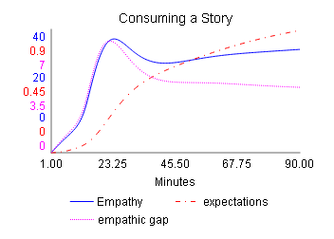
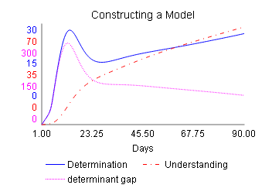
Progress, Insights, and Questions
Parallel Structure – Stories and Models
Empathy corresponds to Understanding
The progression dynamics are the same
Next, translate story craft insights to modeling
Thoughts, feedback, and questions welcome
3:30-5:00
@systemdynamics_
THE 44TH INTERNATIONAL SYSTEM DYNAMICS CONFERENCE
Delft, Netherlands and Virtually
#isdc2022
THE 40TH INTERNATIONAL SYSTEM DYNAMICS CONFERENCE
Virtually everywhere!
#isdc2026
Notes:
Progress, Insights, and Questions: Do not change the slide title. Again, keep the text short and fonts big. Show structure or behavior – may not be room for both (some flexibility on font for images). No need to conclude, there is always more to be done. Any questions you want to pose to the audience can go here. Note the timing in the bottom right.

Slide 5
THE INTERNATIONAL SYSTEM DYNAMICS CONFERENCE
Instructions: Please do this!!!
1) Prepare your Short Presentation using a copy of this template.
Change the presentation title and author information to match your submission.
Do NOT change the titles of the other slides. Do NOT change the number of slides with content.
Change the body of the slides to present your work, following the instructions in the slide notes.
2) Submit your Short Presentation slides at https://webportal.systemdynamics.org by the Conference Material Submission Deadline
Click on the title of your submission
Select “Upload new or updated paper files”
Upload the Powerpoint presentation file for your Short Presentation slides
3) Follow the format and timing listed below:
You have exactly 5:00 minutes to present, followed by up to 5:00 minutes of discussion.
Keep within the time limits noted at the lower right of each slide.
The session chair will combine your slides with other presentations and will control the screen.
4) You may record your presentation in advance
If you are not able to attend the session, the recording will be used instead
If you do attend, you can ask the chair to play the recording, or present live
Add the YouTube Video ID to the Web Portal under “Review or update paper information”
5) If you make updates or change plans after the Conference Material Submission Deadline, send the session chair a note
Use the contact information at https://isdc.systemdynamics.org
Notes:
This slide will be hidden from presentation. You may delete this instruction slide once your slides are ready.

